Slide 1
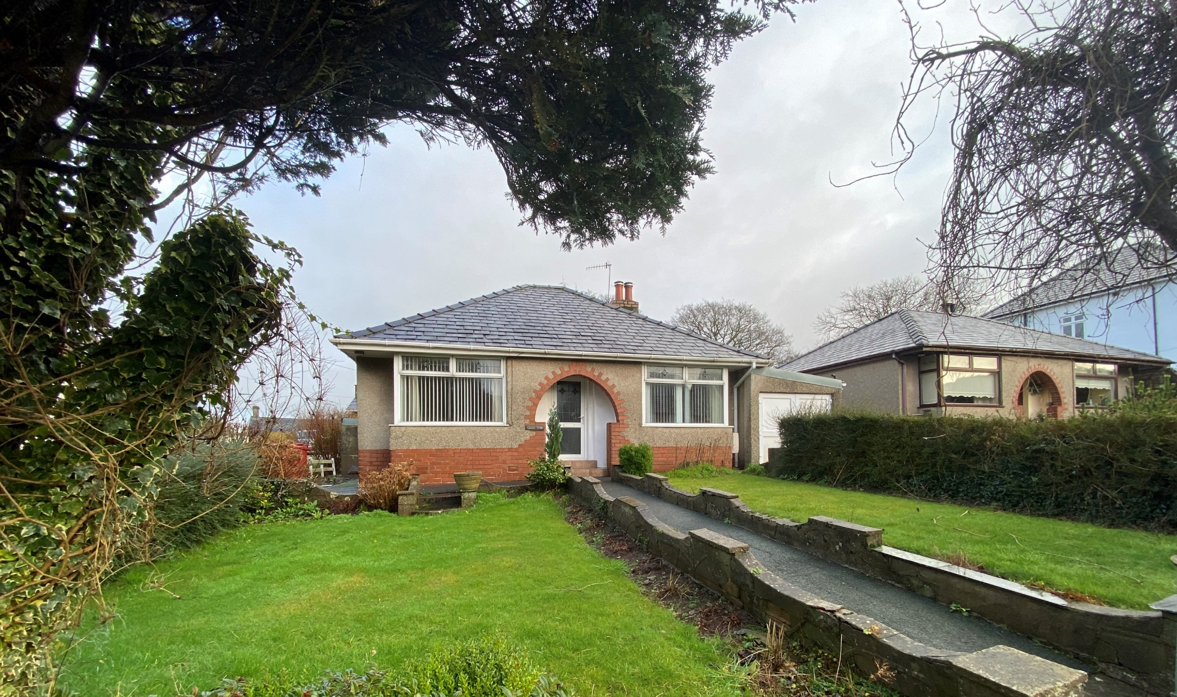
Glen Tor
Greystone Lane
Dalton-in-Furness
LA15 8PX
Guide £260,000

Slide 2
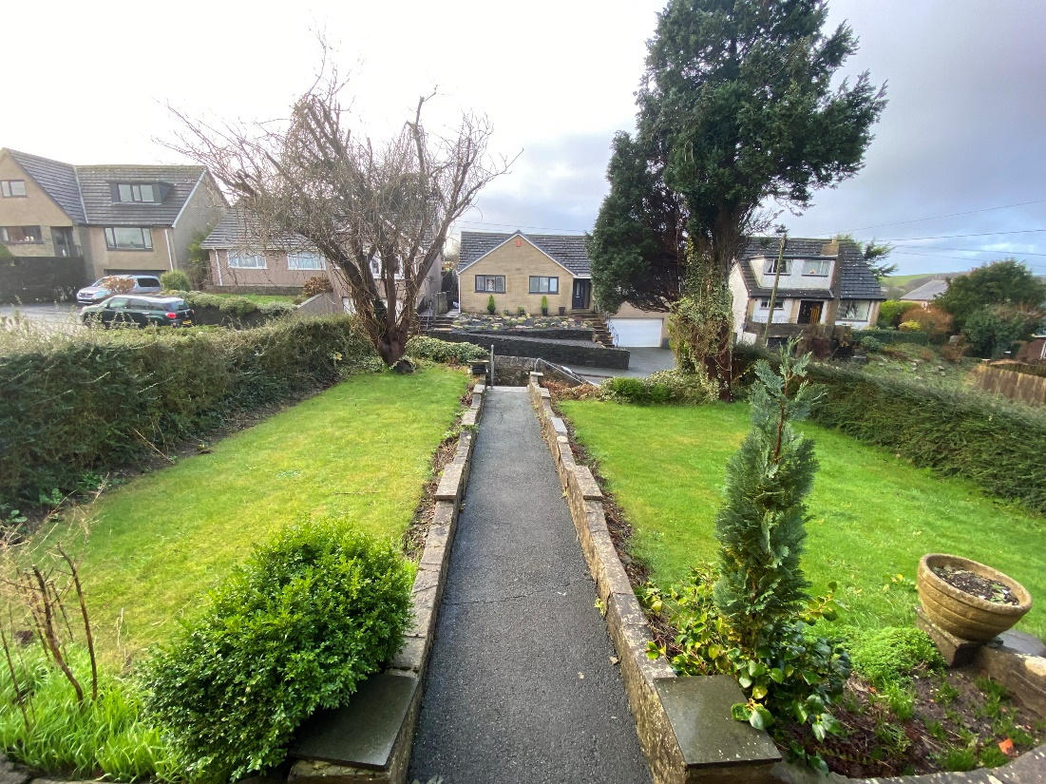
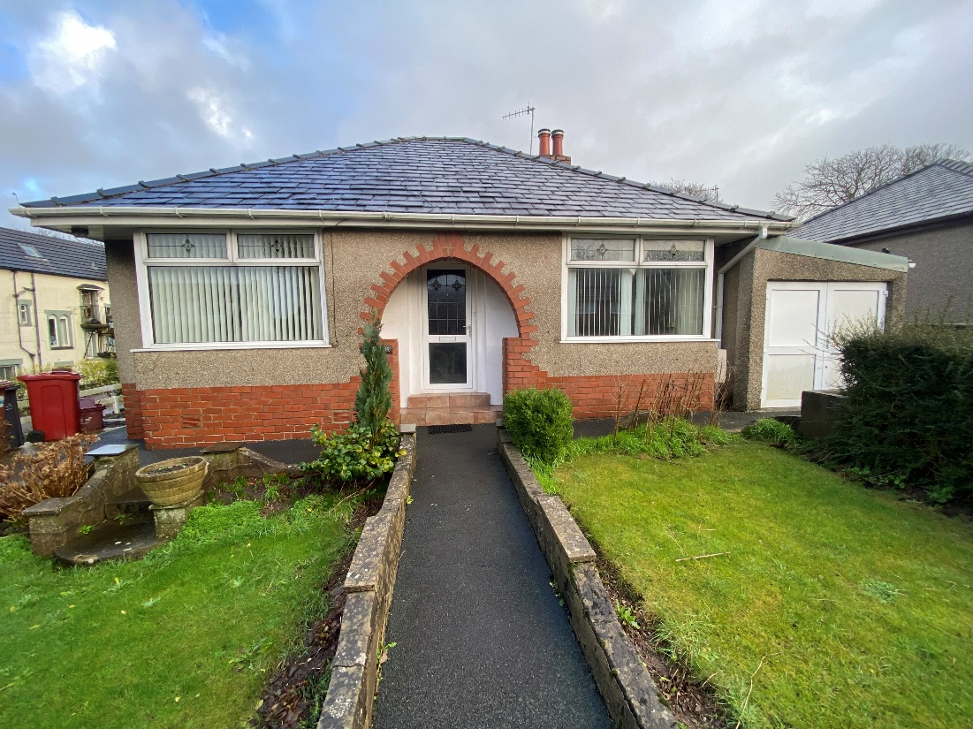
Description
A desirable two bedroom detached bungalow on Greystone Lane in Dalton-in-Furness. The property has been well maintained, but needs updating, there is no upper chain.
The accommodation comprises: Entrance Hallway, Reception Room, Two double bedrooms, a Family Shower Room, a Dining Room and a Kitchen.
Externally there is a lawned front garden with flower borders and mature trees, and a tarmac path leading to the front door, along with a tarmac driveway, and single garage. To the side of the property there is a vegetable garden, leading to a good size rear garden with storage shed and patio area and a pedestrian door into the garage.

Slide 3
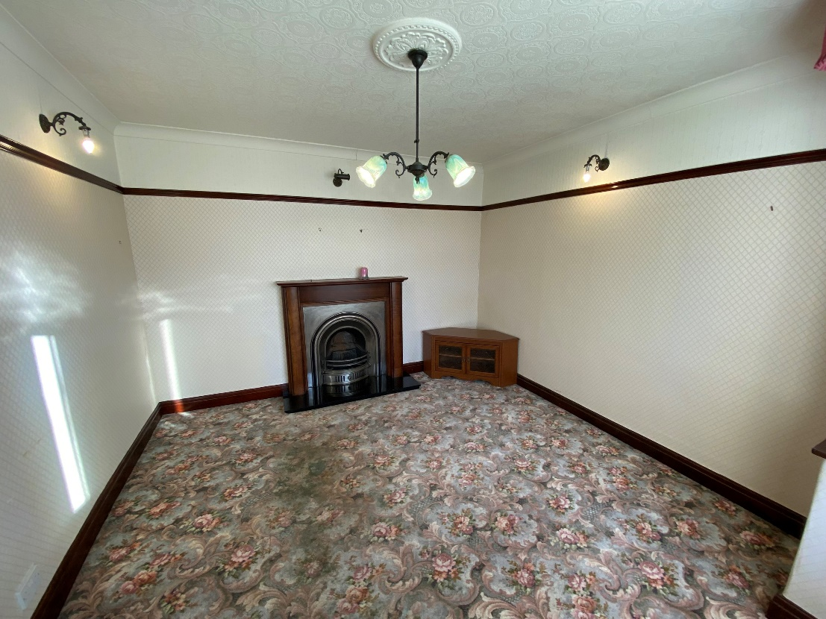
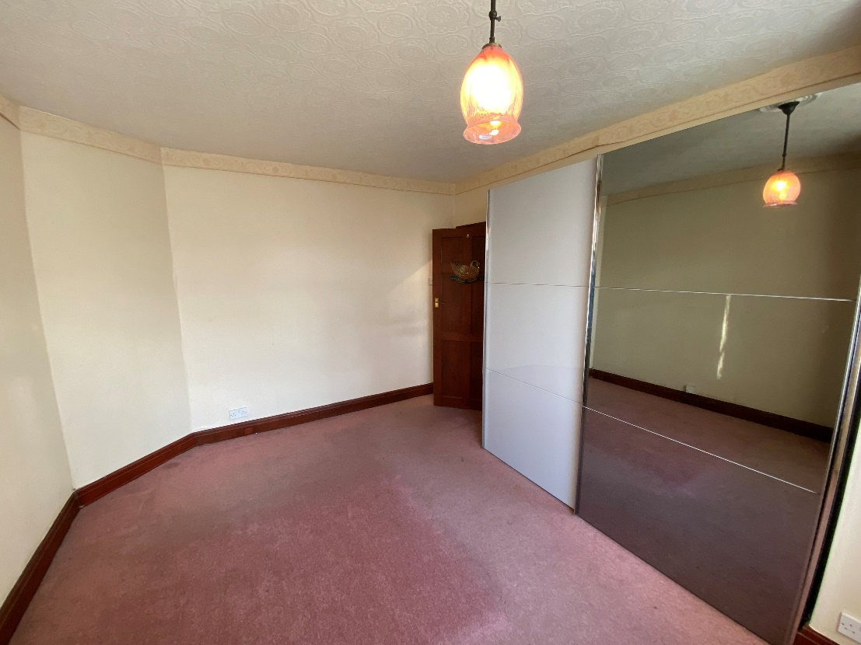
Entrance Hallway: A uPVC front door into the large hallway, with a radiator and doors leading into the reception room, bedrooms 1 and 2, the family shower room and dining room.
Reception Room: A living room with a uPVC double glazed bay window overlooking the front garden. The room has an open fireplace with a wooden mantelpiece and surround, and a radiator.
Bedroom 1: A good size double bedroom with two large double wardrobes and a radiator. The uPVC bay window overlooks the front garden.
Bedroom 2: A double bedroom with a uPVC window overlooking the rear garden and a radiator.

Slide 4
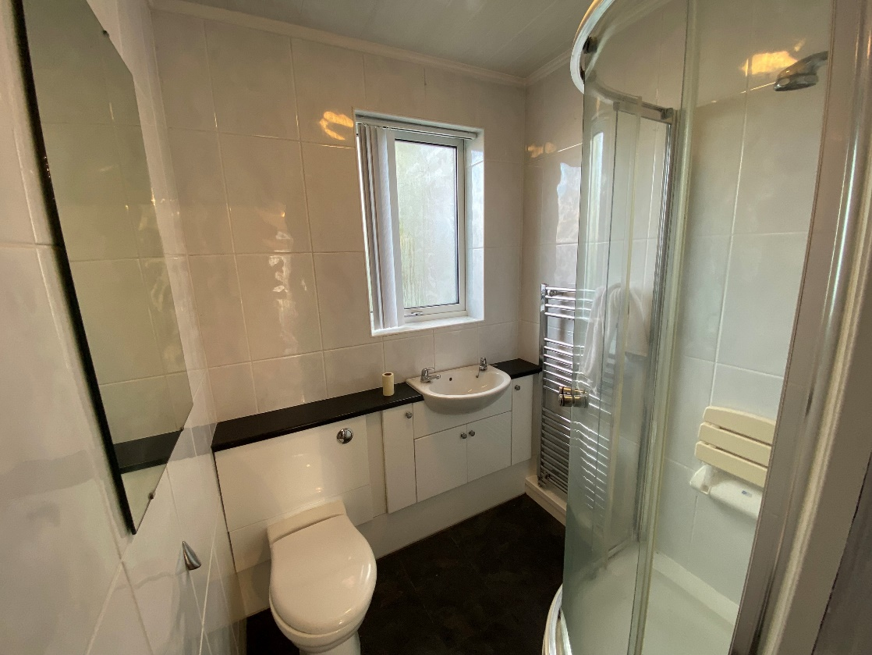
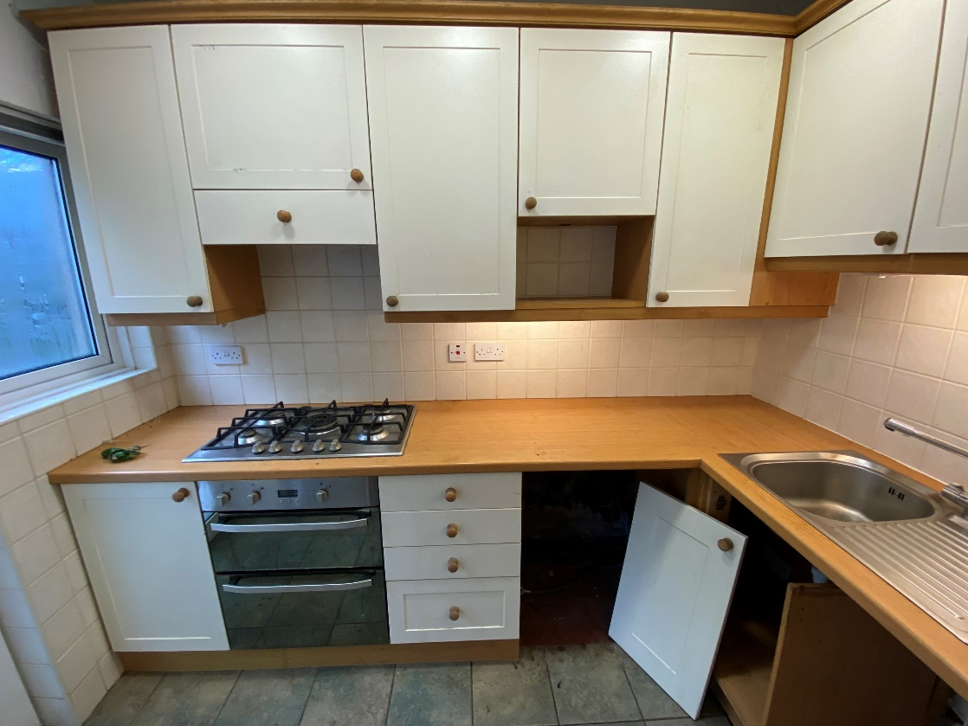
Family Shower Room: There is a toilet, sink unit and shower cubicle, with a heated towel rail and a uPVC double glazed window.
Dining Room: A large light and airy room with uPVC dual aspect windows and double patio doors into the rear garden. There is a gas fire, a radiator and a door into the kitchen.
Kitchen: The kitchen is accessed via the dining room. There are fitted wall and base units, a sink with side drainer, a gas hob and cooker and a heated towel rail. There is a uPVC double glazed window overlooking the patio area and a uPVC door to the rear garden.

Slide 5
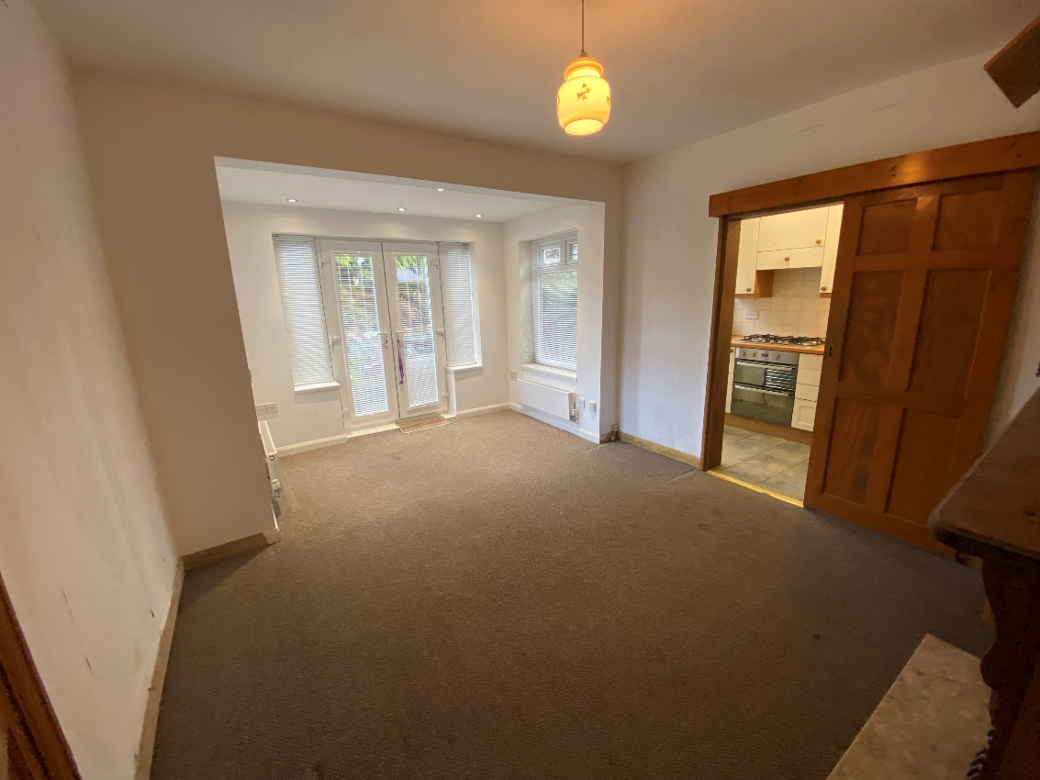
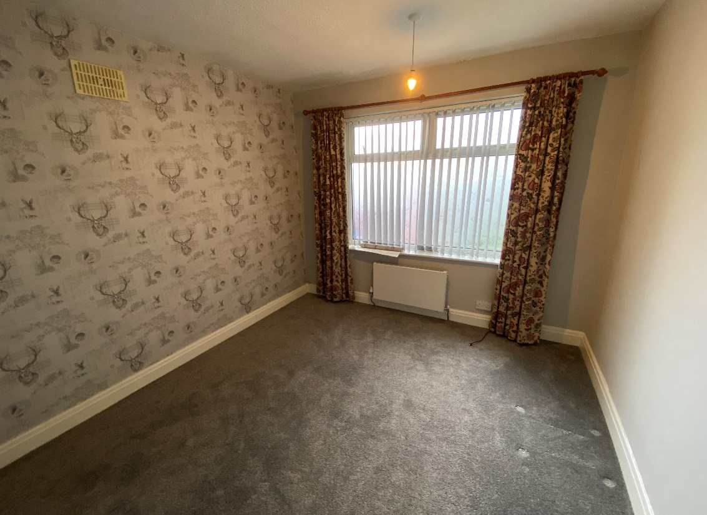
Outside: The property has a tarmac driveway leading to the single garage which houses the Valiant gas boiler and provides off street parking.
The front of the property has steps and a footpath leading to the front door with an open porch. There is a lawned front garden either side of the footpath with flower borders and mature trees.
To the side of the property there is a paved bin storage area and a vegetable garden and a paved path leading to the rear which has a storage shed and ample space for a greenhouse, a lawned area and a patio area.
There is a paved path around the property, which is ideal for access.

Slide 6
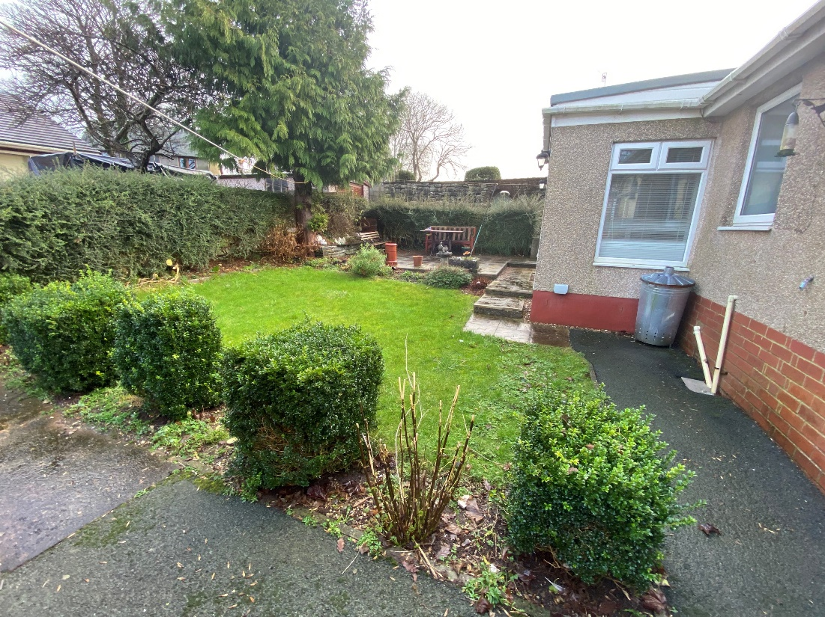
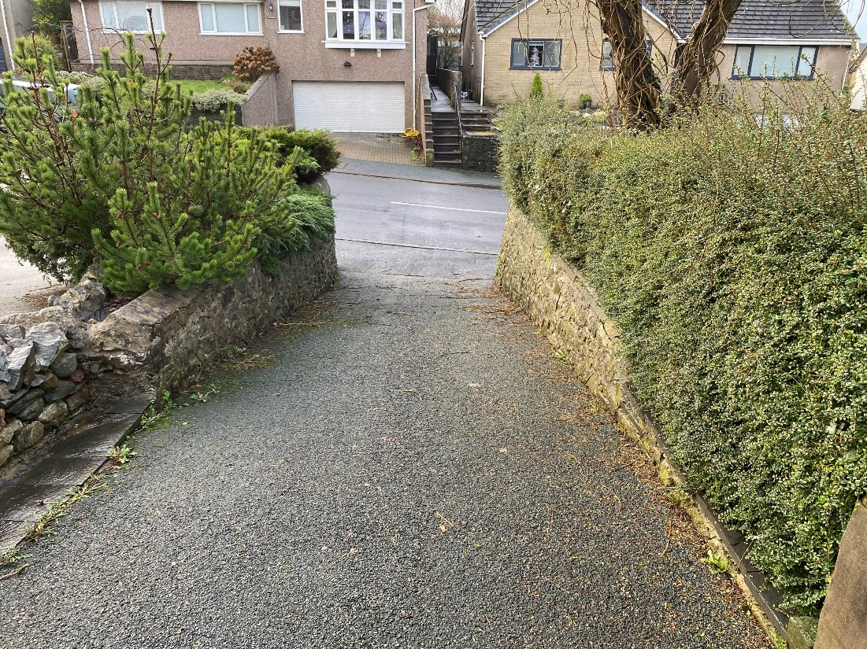
Tenure:
Freehold.
Wayleaves/Easement:
The property is sold subject to, and with the benefit of, all rights of way, whether public or private, any existing or proposed wayleaves, easements or quasi easements, whether referred to within these particulars or not.
Services:
The property is connected to mains Electricity, Gas, Water and Drainage.
Local Authority:
Westmorland and Furness Council.
Council Tax:
Band C

Slide 7
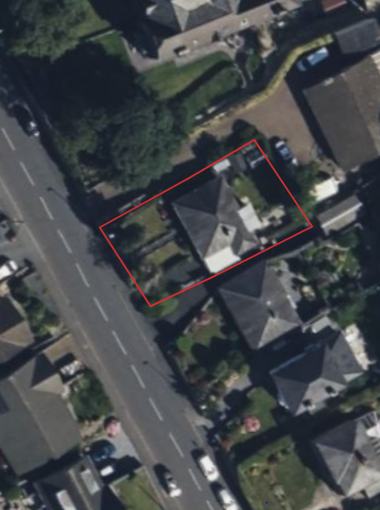
Site Plan
Location:
Glen Tor is located in the desirable residential area of Greystone Lane, Dalton-in-Furness.
Inspections:
By appointment only with the selling agent, UAM Property.
Directions:
From Elliscales roundabout on the A590 take the exit into Dalton-in-Furness taking the turning onto Station Road leading onto Greystone Lane, the property is on your left.
reconnect.customers.farmed

Slide 8
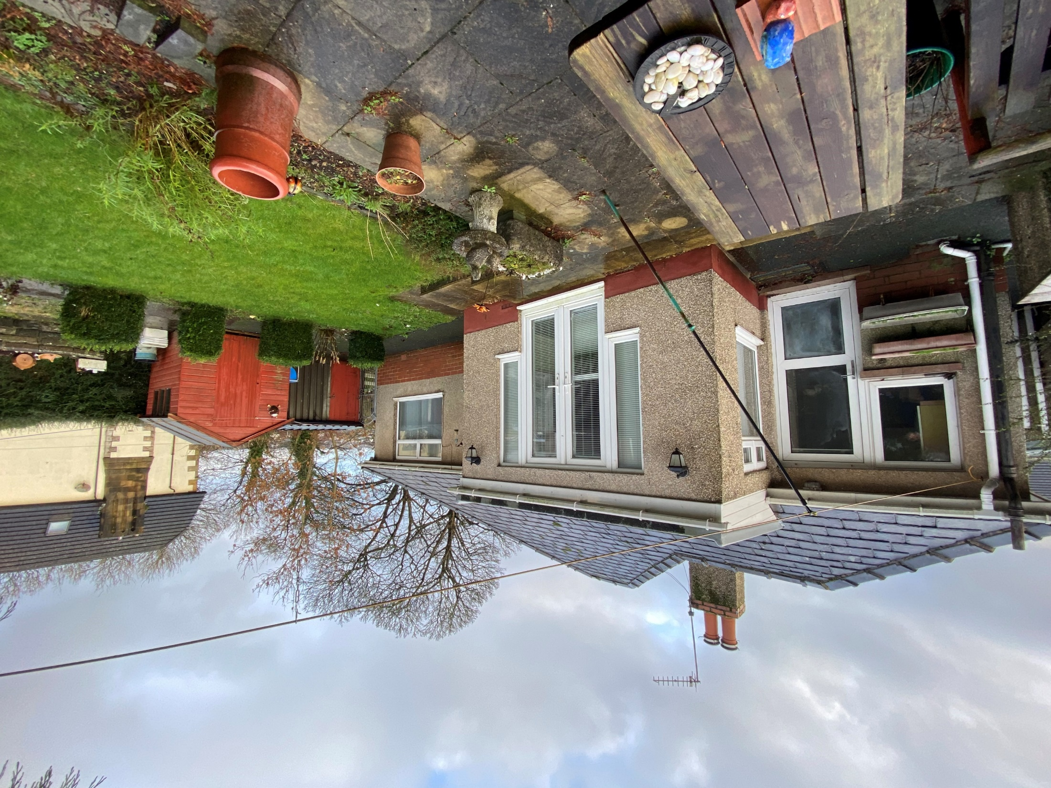
UAM Property, County Square, Ulverston, Cumbria, LA12 7AB 01229 583026/ 01229 582056 property@ulverstonauctionmart.co.uk www.uamproperty.co.uk
MISREPRESENTATION ACT 1967 (NOTICE)
These particulars do not constitute any part of, an offer or a contract. All statements contained in these Particulars are made without responsibility on the part of the Vendors and Agents. No statements contained in these Particulars are to be relied on as Statements or representations of fact. Intending Purchasers must satisfy themselves by inspection or otherwise as to the correctness of each of the Statements contained in these Particulars. The Vendors do not make or give, and neither Messrs Harrison Coward nor any person in their employment has any authority to make or give, any representation or warranty whatever in relation to this Property. The Property is offered subject to Contract and to remaining unsold.

